Slide 1
Portfolio Executive Committee (PEC)
Review Meeting
Metalyse & Actilyse Overview
  Jiaqi Lu, Leo Bao | 22nd Apr, 2024 | 15 min

Slide 2


China BLA Overview
Metalyse TNK-tPA — Acute Ischemic Stroke (AIS)
2023 | 2024 |  |  |  |  |  |  |  |  |  |  |  | 2025
 | 1 | 2 | 3 | 4 | 5 | 6 | 7 | 8 | 9 | 10 | 11 | 12 | Q1 | Q2 | Q3 | Q4
today
Global
EMA BLA-sub
24Jul
EMA BLA-app
12Jan
China
Pre-BLA CMC
Online sub: NIFDC
Apr
Sub
Feedback
11Sep
11Oct
Samples: Sub
End of Apr
NIFDC: Conduct test
90 WDs
Samples: Ready
Mar
QC-testing: Report to CDE
Oct
QC testing
Local Repack
Apr 2025
BLA Review Process
BLA process
GCP Inspection
acc→DL: 200WD
BLA-sub
28Dec
BLA-acc
22Jan
Inspection:
Notification
13Mar
Inspection:
Report to CDE
Sep
DL
Nov
DL response
Dec
BLA-app
31Mar2025
Inspection:
On-site May
Inspection:
CFDI conclusion Jul
sub: submission
acc: acceptance
app: approval
DL: Deficiency Letter
CDE review status:
Currently under review, expect to receive CDE questions starting from Jul-Aug 2024.
New CCDS expected to be ready in Aug 2024, with company position on low body weight limitation and etc.
Team will discuss if can take DL response chance to submit the new analysis data.

Slide 3
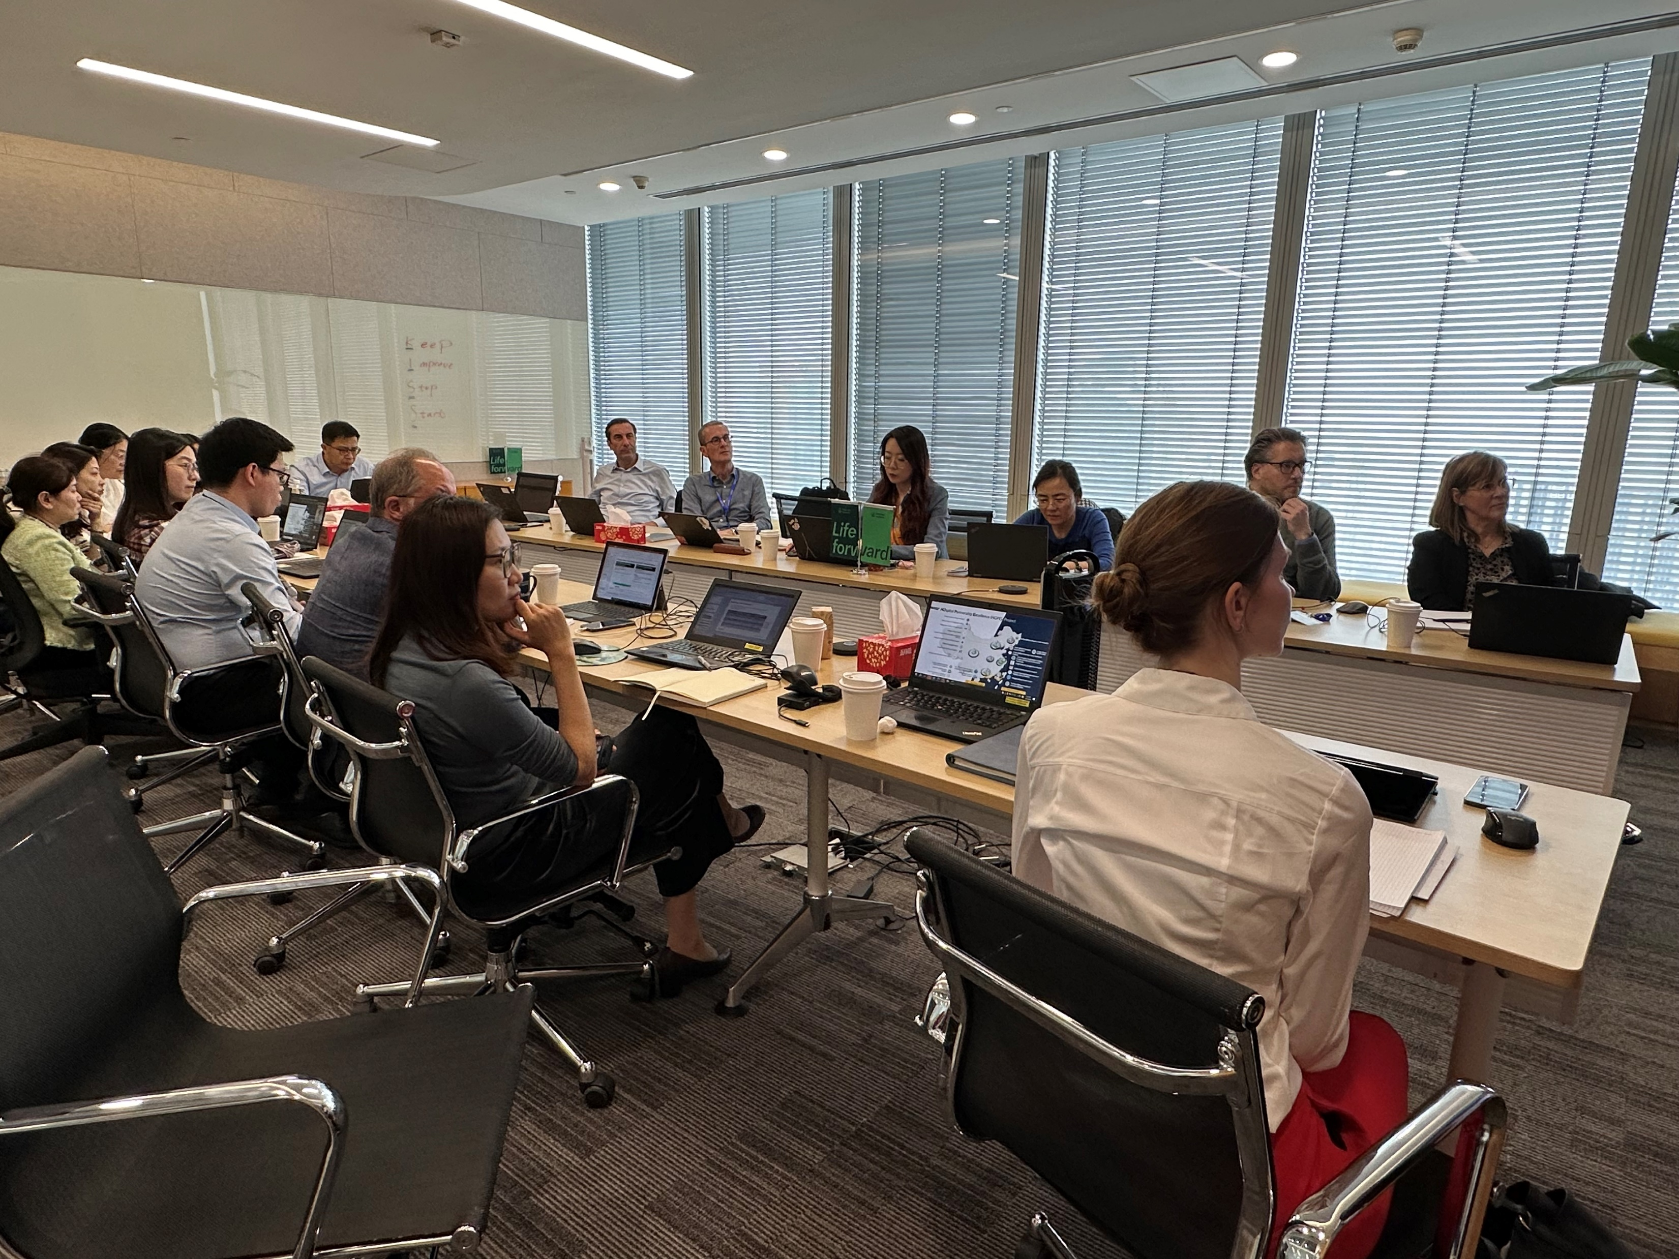
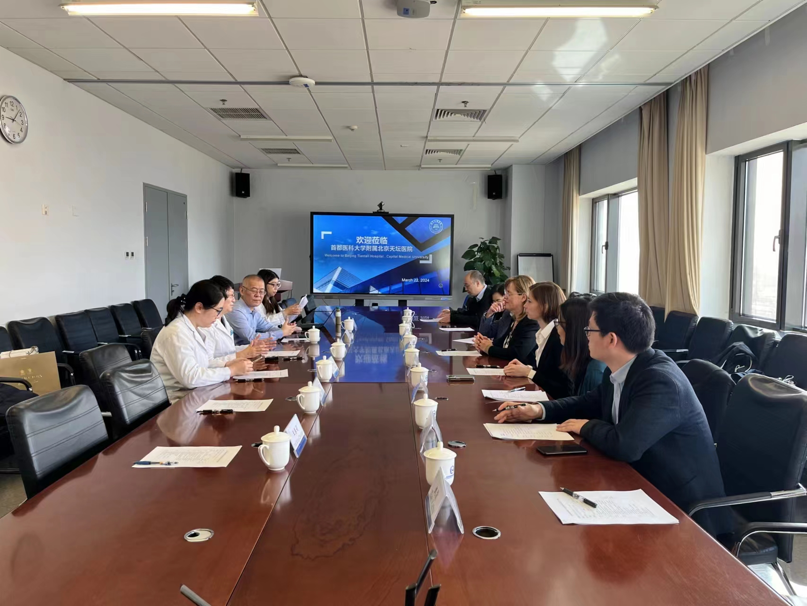
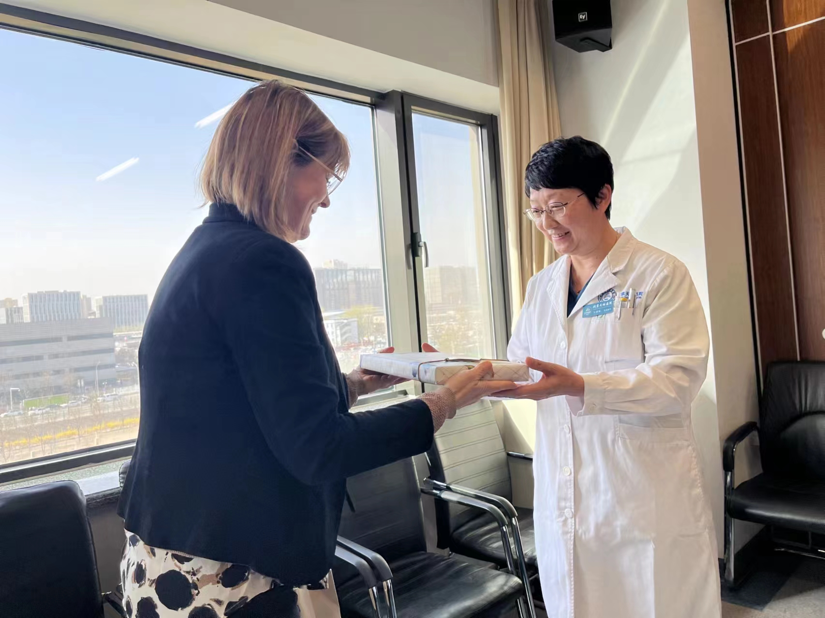
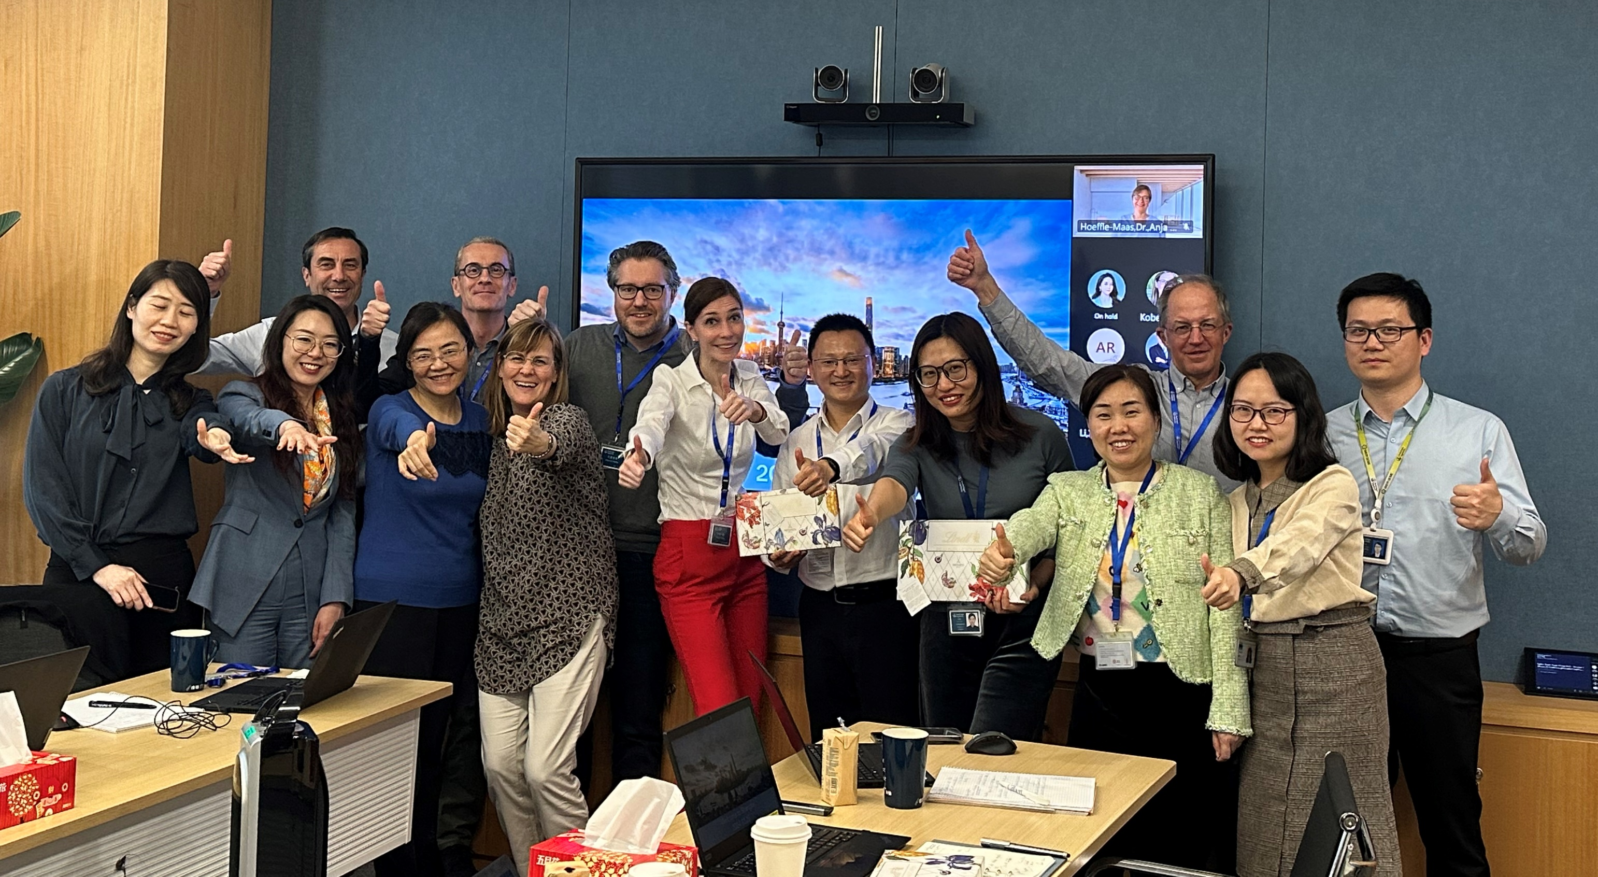
Lytics AT CN Visit - successful global visit and productive exchange meeting with great teamwork
Date: Mar 25th – 28th , 2024
Highlight activities:
  Evidence/Value/Drug Device extensive exchange
  Metalyse LRR preparation
  Corporate Senior Management exchange
  Metalyse IAP co-creation
  KEE Visits

Slide 4
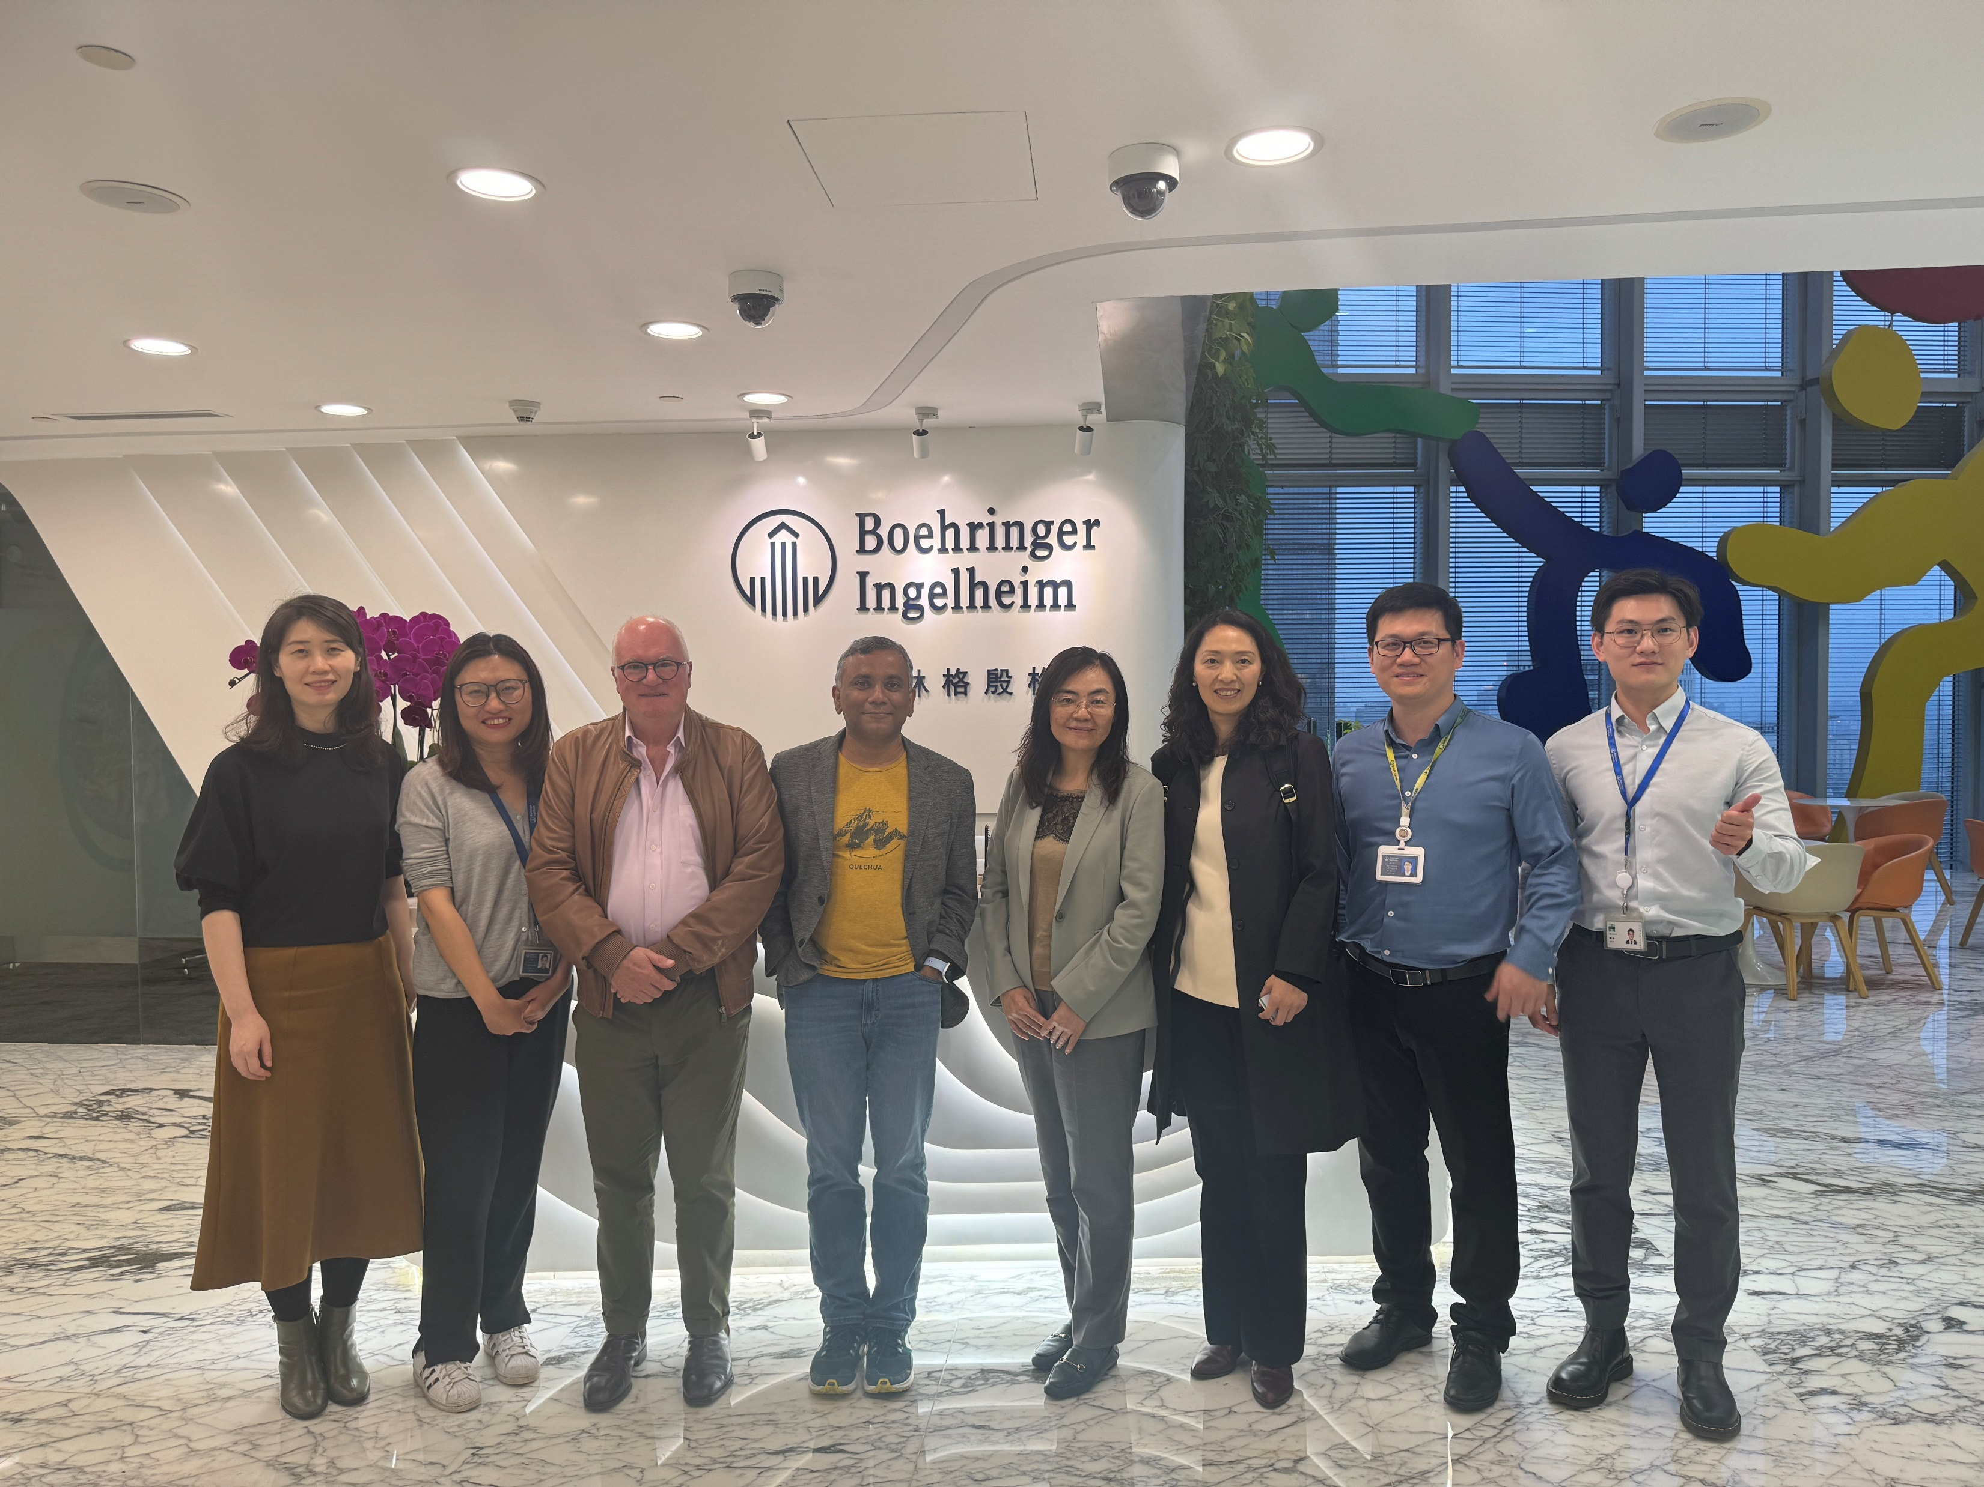
Meet with Bijoy and Craig on ACT-Global
Way of collaboration with Tiantan
Definition of Co –leading
Further clarify the steering committee mechanism to Prof Wang
Tiantan’s expectation for ACT-GLOBAL
Ø BP domain, thrombolysis domain and SAH domain
Ø Prof. Bijoy Menon and Prof. Wang as Co-PIs for
Thrombolysis Domain
Ø First trial: Low dose TNK for patients with NOAC

Slide 5
Global visit follow up action summary
Highlights for Metalyse Evidence:
CCDS update – keep close working together with global team
Maximization –
  Aligned Corporate to lead the late time window study as a MRCT.
  Aligned China to join in the "ETERNAL" trial

Slide 6
Metalyse TNK-tPA & Local Competitors Development Timeline (as of 16Apr2024, Best case)
today
2021 |  |  |  | 2022 |  |  |  | 2023 |  |  |  | 2024 |  |  |  | 2025 |  |  |  | 2026 |  | 2027
Q1 | Q2 | Q3 | Q4 | Q1 | Q2 | Q3 | Q4 | Q1 | Q2 | Q3 | Q4 | Q1 | Q2 | Q3 | Q4 | Q1 | Q2 | Q3 | Q4 | Q1 Q2 | Q3 Q4 | Q1 Q2 | Q3 Q4
Metalyse- BI
Ph III, 1478 pts, 50 site, FPI-LPO: 14 Jul 2021 – 08 Oct 2023
BLA-s
(28 Dec’23)
BLA-a
(Mar’25)
Launch
(Jul’25)
Local TNK- CSPC
Ph III, 1430 pts, 66 sites,
FPI-LPO: 12Jun2021 – 29May2022
BLA-s
(16Nov’22)
BLA-a & Launch
(30 Jan’24)
Fenghua re-submitted the BLA for STEMI indication in Aug 2023, which may impact the review timing for AIS as 2nd indication. Currently the BLA review is pending.
Fenghua AIS is under DBL progress but may face the financial crisis, so the BLA submission timeline is TBD.
Fenghua | 2023 |  |  |  | 2022
 | Sep 29 (LPI) | May 08 | Mar 07 | Feb 14 | Dec 08 | Oct 26
Recruited pts | 1630 | 1066 | 594 | 456 | 111 | FPI
Ph III, 1630 pts, 60 sites,
FPI-LPO: 26 Oct 2022 – Dec 2023
BLA-s
(TBD)
BLA-a & Launch*
(TBD)
Local TNK- Fenghua
BLA-a for STEMI
(Aug’24)
Reteplase | 2023 | 2023 | 2022 | 2022
status | 30 | 05 | 06 | 25 | 21
 | Mar | Jan | Dec | Oct | Mar
Recruited pts | LPI | 1377 | ~1340 | 1300+ | FPI
BLA-a & Launch
(Feb’25)
Local rPA – Crbiopharm
Ph III, 1412 pts, 93 sites,
FPI-LPO: 21 Mar 2022 – Jun 2023
BLA-s
(05Feb’24)
Pro-Urokinase – Tasly
LPI 1552 pts recruited by 03Dec2023
Ph III, 1552 pts, 72 sites,
FPI-LPO: 29Jan2023 – Mar 2024
BLA-s
(Jun’24)
BLA-a & Launch
(Jun’25)
Notes:
LPO – BLA submission for all local products: 3M (without pre-BLA meeting).
Metalyse & Fenghua: Metalyse uses the best case scenario. BLA approval is assumed by using NME & non-priority review pathway timeline (15m).
Local rPA-Crbiopharm & Pro-Urokinase: BLA approval is assumed by using indication extension CDE review timeline (12m).

Slide 7
Actilyse Progress

Slide 8

Actilyse contraindication (＞80yrs) removal overall regulatory strategy
2023 |  |  |  | 2024 |  | 2025
Q1 | Q2 | Q3 | Q4 | Q1 | Q2 | Q3 | Q4
today
Global
Restrictions on >80 y was removed in label by EU since Jun 2018.
China
Original Plan
CN Variation (200WDs)
Aug. 2024 (if no formal queries)
Variation sub:
18th Aug. 2023
Variation App.
China
Feedback from CDE on 19 Apr.2024 :
Acknowledge the significant unmet treatment needs in elderly (> 80ys) pts in China;
The local study (0135-0349) showed numerically higher one-year all-cause mortality (39.5% vs 38.8%) and in-hospital any intracranial haemorrhage (13.7% vs 10.8%) in Actilyse group which is hard to provide strong justifications for safety consideration；
Suggest Sponsor to withdraw the current application AND re-submit it following the route of “境外已上市境内未上市药品临床技术要求“, with the content mainly based on global data and supplemented by Chinese data；
CN Variation (80WDs)¹
Best case²：Oct. 2024
Current Plan
Withdraw
Apr 24th
Re-sub:
Early Jun. 2024
Variation App.
No GCP inspection is expected.
Best case: If no formal deficiency letter issued, no panel meeting or CDE internal meetings required, approval is expected in Oct 2024.
8

Slide 9
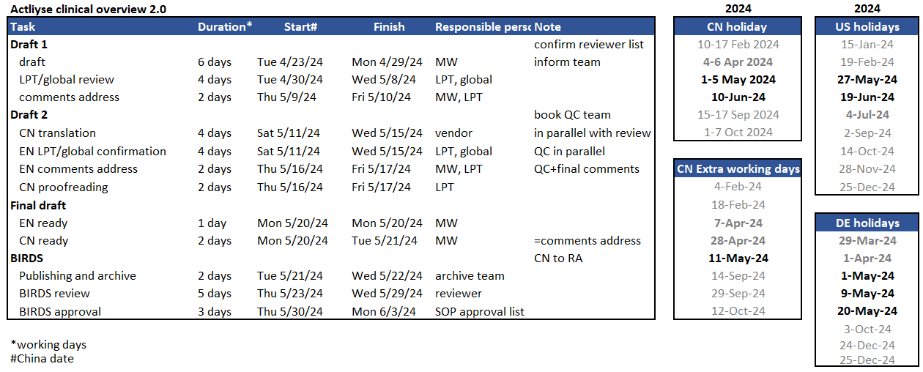
Actilyse resubmission clinical overview 2.0 timeline (BACKUP)

Slide 10
Thank You !

Slide 11
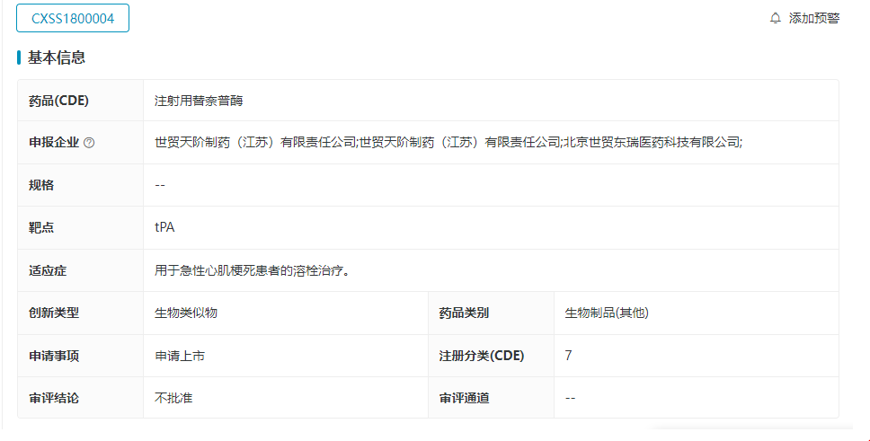
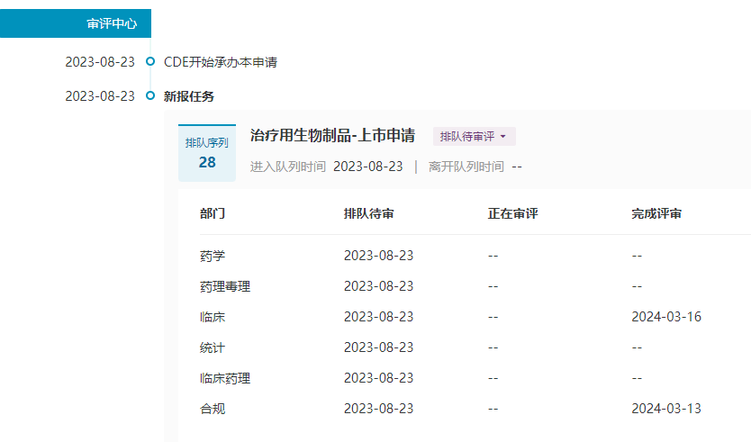
Fenghua TNK Current Status
today
2023 |  |  |  | 2024 |  |  |  | 2025 |  |  |  | 2026 |  | 2027
Q1 | Q2 | Q3 | Q4 | Q1 | Q2 | Q3 | Q4 | Q1 | Q2 | Q3 | Q4 | Q1 Q2 | Q3 Q4 | Q1 Q2 | Q3 Q4
Metalyse- BI
BLA-s
(28 Dec’23)
BLA-a
(Mar’25)
Launch
(Jul’25)
Local TNK- Fenghua
-AIS
BLA-s
(Apr’24)
BLA-a & Launch*
(Jul’25)
Local TNK- Fenghua
-STEMI
BLA-sub
(Feb’18)
BLA-Rejection
(Oct’21)
According to intelligence, 1st STEMI BLA was rejected due to unsuccessful GMP inspection and Covid-19 impact.
BLA-resub
(Aug’23)
BLA-a-best
(Aug’24)
BLA-a-base
(Nov’24)
Current Status:
CDE Clinical review finished on 2024-3-16, which took 140wds. Other departs review are not yet finished. Resub with same data package may be the cause for faster CDE review.
Best case assumption:
  140-160WD for other CDE departs review
  DL response timeline unchanged
  Inspection is not speeding limiting step

